Slide 1
S. A. ENGINEERING COLLEGE (An Autonomous Institution Affiliated to Anna University Chennai) by NBA, NAAC 'A' Grade & ISO 9001:2015 Certified Institution Department of CSE
MINI PROJECT REVIEW

Slide 2

Project Report: STELLARBASIN
PROJECT TITLE:
STELLARBASIN: A Machine Learning Model Visualizer
DOMAIN:
Machine Learning & Data Visualization
AUTHOR’S NAMES:
Joshua Gigo Peter, Hemanth R, Babishmon P
INSTITUTION:
S. A. ENGINEERING COLLEGE
DEPARTMENT/YEAR:
Computer Science Engineering/ III Year

Slide 3

Table of contents
01

Slide 4


STELLARBASIN is a web-based application designed to enhance the interpretability of trained machine learning models. It supports Decision Trees, K-Nearest Neighbors, Linear Regression, and Logistic Regression, offering clear and interactive visualizations. The platform allows users to upload pre-trained models and input sample data to see real-time predictions, helping them understand how the models function. Built using Python, Flask, Dash, and visualization libraries such as matplotlib, seaborn, and plotly, STELLARBASIN ensures a user-friendly experience without requiring extensive coding knowledge. The tool aims to assist data scientists, analysts, and non-technical users in gaining insights into machine learning models by simplifying complex decision-making processes into easily interpretable visual formats.
Abstract

Slide 5

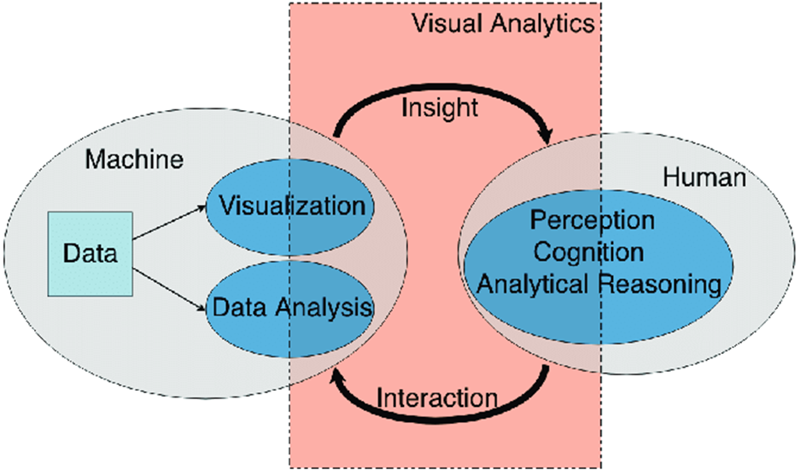

​
Confidence-building strategies
Relationship between interpretability, visual analytics, and human understanding.

Slide 6

Objectives:
To develop an interactive visualization tool for trained machine learning models.
To provide users with clear and intuitive visual representations of Decision Trees, K-Nearest Neighbors (KNN), Linear Regression, and Logistic Regression models.
To enhance model interpretability by allowing users to upload pre-trained models and receive graphical insights.
To build a user-friendly dashboard using Dash for seamless interaction.*
To assist data scientists, analysts, and non-technical users in understanding model predictions through interactive and customizable visualizations.

Slide 7

Problem Definition:
STELLARBASIN tackles the challenge of model interpretability in machine learning, especially for structured data. While complex models offer high accuracy, their decision-making process is often opaque, posing trust and validation issues in critical fields like healthcare, finance, and law.
Unlike deep learning visualization tools like ActiVis, intuitive solutions for classical models—Decision Trees, KNN, Linear Regression, and Logistic Regression—are lacking. Existing methods require manual coding, limiting accessibility for non-programmers.
STELLARBASIN simplifies this by providing an interactive, automated visualization platform. Users can upload pre-trained models to generate clear graphical representations, enabling exploration of model decisions, feature importance, and prediction validation.

Slide 8

Project Classification: Application – STELLARBASIN is a functional application designed for users to analyze and interpret machine learning models. It serves as a tool rather than a research study or theoretical review. Project Type: Inhouse Development – This project is independently developed without industry collaboration. It is designed as an open-source initiative to aid in machine learning interpretability.

Slide 9

Environmental Considerations: STELLARBASIN enhances responsible AI by improving model interpretability, helping detect and mitigate biases. While it has no direct environmental impact, it supports sustainability-related AI by increasing transparency in models used for environmental monitoring. Being lightweight, it consumes minimal energy compared to large-scale AI systems. Ethical Considerations: Fairness & Transparency: Visualizations reveal model decisions, aiding bias detection and accountability. Preventing Misuse: Clear guidance ensures correct result interpretation, reducing ethical risks. Privacy Protection: No models are stored; processing is local, ensuring data security. Open-Source: Publicly available to promote inclusivity, knowledge sharing, and ethical AI use.

Slide 10
Hardware and Software Specifications:
Hardware Requirements:
Processor: Intel i5/i7 or AMD equivalent
RAM: Minimum 8GB (16GB recommended for handling larger models)
Storage: At least 10GB of free space
GPU: Optional (for potential future deep learning expansions)
Software Requirements:
Programming Language: Python 3.x
Development Environment: VS Code
Web Framework: Flask, Dash, Dash Bootstrap Components
Machine Learning Libraries: scikit-learn, joblib, pandas, numpy
Visualization Libraries: matplotlib, plotly, seaborn
File Handling: os, pickle

Slide 11
8. Related Works / Literature Survey:
Several existing tools aim to visualize machine learning models, but most are focused on either deep learning interpretability or require advanced programming skills. Some of the notable works in this field include:
ActiVis (Facebook AI Research): A tool designed for visualizing deep learning models but lacks support for classical ML models.
SHAP (SHapley Additive exPlanations): A framework for explaining model predictions but requires coding and lacks an intuitive UI.
LIME (Local Interpretable Model-Agnostic Explanations): A model interpretation tool that provides local explanations but is not built for interactive, user-friendly visualization.
Scikit-learn's Built-in Plotting Functions: While scikit-learn provides visualization for models like Decision Trees, these are static and not user-interactive.

Slide 12
explAIner: A Visual Analytics Framework for Interactive and Explainable Machine Learning FairSight: Visual Analytics for Fairness in Decision Making Explaining Vulnerabilities to Adversarial Machine Learning through Visual Analytics

Slide 13
Effective delivery techniques​
Voice modulation is a powerful tool in public speaking. It involves varying pitch, tone, and volume to convey emotion, emphasize points, and maintain interest:
Pitch variation​
Tone inflection​
Volume control
Effective body language enhances your message, making it more impactful and memorable:
Meaningful eye contact
Purposeful gestures
Maintain good posture
Control your expressions

Slide 14

Speaking impact​
Your ability to communicate effectively will leave a lasting impact on your audience​
Effectively communicating involves not only delivering a message but also resonating with the experiences, values, and emotions of those listening

Slide 15
Dynamic delivery​
Learn to infuse energy into your delivery to leave a lasting impression​
One of the goals of effective communication is to motivate your audience
Metric​ | Measurement​ | Target​ | Actual​
Audience attendance​ | # of attendees​ | 150​ | 120​
Engagement duration​ | Minutes​ | 60​ | 75​
Q&A interaction​ | # of questions​ | 10​ | 15​
Positive feedback​ | Percentage (%)​ | 90​ | 95​

Slide 16
Final tips & takeaways​
Consistent rehearsal​
Practice makes perfect, so strengthen your familiarity with the presentation​
Refine delivery style​
Pacing, tone, and emphasis​
Timing and transitions​
Aim for seamless, professional delivery​
Practice audience
Enlist colleagues to listen & provide feedback​
Seek feedback​
Reflect on performance​
Explore new techniques​
Set personal goals​
Iterate and adapt

Slide 17
Speaking engagement metrics​
Impact factor​ | Measurement​ | Target​ | Achieved​
Audience interaction​ | Percentage (%)​ | 85​ | 88​
Knowledge retention​ | Percentage (%)​ | 75​ | 80​
Post-presentation surveys​ | Average rating​ | 4.2​ | 4.5​
Referral rate​ | Percentage (%)​ | 10​ | 12​

Slide 18

THANK YOU
Brita Tamm​
502-555-0152​
brita@firstupconsultants.com​
www.firstupconsultants.com

